Slide 1
NVIDIA WaveWorks 1.6

Slide 2
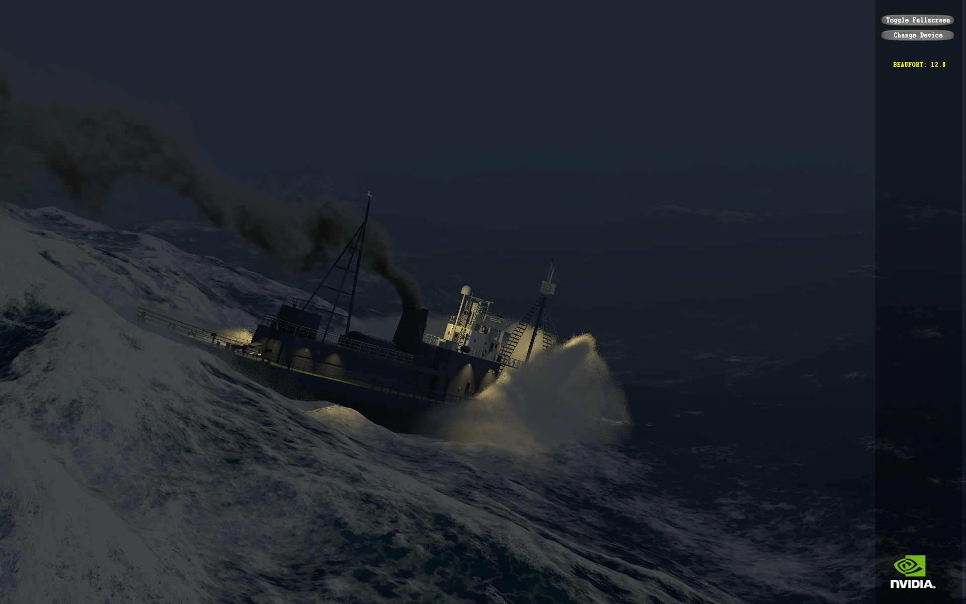
NVIDIA WaveWorks
...a library for simulating wind-driven waves on large bodies of water, in real time, using GPU acceleration
(BUT: the application still defines the look)

Slide 3
Mission space
Beaufort 12
Wide range of weather conditions
GPU
Beaufort 1
Range of hardware
CPU
1cm features
1km features
Range of
lengths

Slide 4
Detour: The Beaufort scale
An empirical observation-based wind speed scale
Devised 1805 by Francis Beaufort, British Navy
Originally 0 to 12
0 = Flat
6 = Long waves begin to form. White foam crests are very frequent. Some airborne spray is present.
12 = Huge waves. Sea is completely white with foam and spray. Air is filled with driving spray, greatly reducing visibility.
Modern extensions to 13 and more

Slide 5
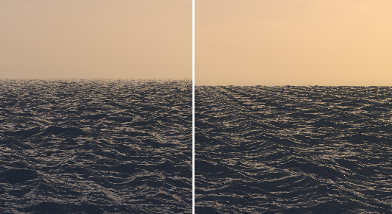
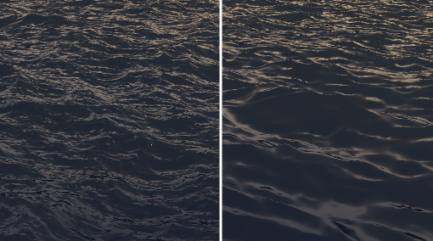
The length range challenge
Need both uniqueness and fine detail for a simulation to look good
UNIQUENESS: minimize objectionable repeating patterns over large areas
FINE DETAIL: accurately portray near-camera short-wavelength features

Slide 6
The length range challenge
WaveWorks supports a length range of 64,000 : 1 –
64,000 represents the uniqueness dimension within which the simulation produces non-repeating results
1 is the finest spacing of height samples seen near-camera
e.g. 1.5cm detail vs. 1km uniqueness
Handles 1km-order wavelengths
- Beaufort 12 relevance

Slide 7
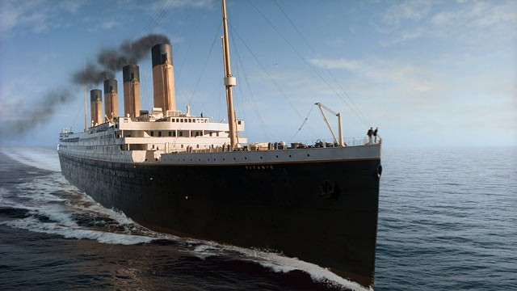

The algo
Tessendorf’s algo, based on Phillips spectrum
Waterworld & Titanic - ’97 : Life of Pi more recently
Simulation step runs in <2ms on GTX680 at max setting

Slide 8
Explainer: the Phillips spectrum
Predicted by Phillips in 1950s, working from first principles of Fluid Mechanics
Subsequently validated by experimental oceanographic data in 1960s
Models a ‘fully developed’ sea state
So a great choice for ‘default’ spectrum
NB: rest of algo is spectrum-agnostic

Slide 9
Explainer: the Phillips spectrum

Slide 10
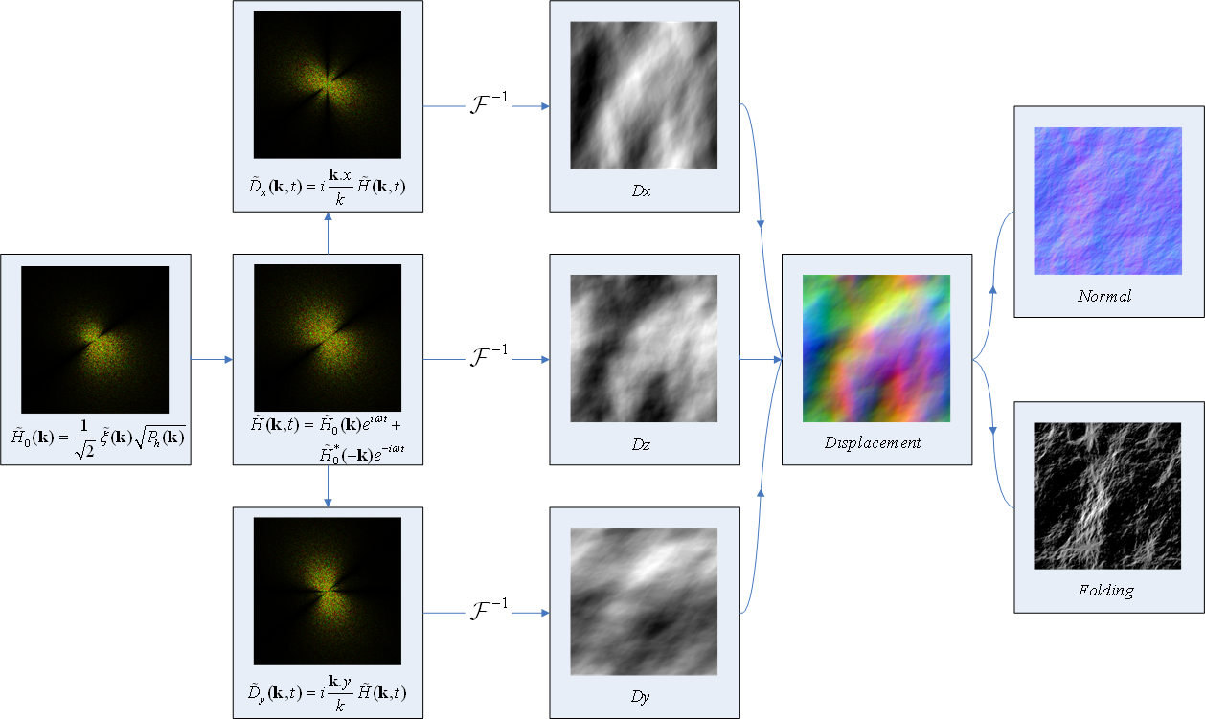
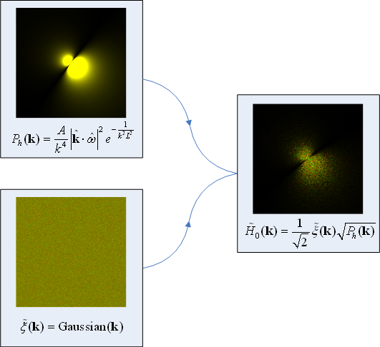
Simulation pipeline
Per-params-change (CUDA/CPU)
Per-frame (CUDA/CPU)
Per-frame (PS)

Slide 11
Overview of Version 1.5
Multi-res simulation for 64,000 : 1 length range
Geometry LODing
Coarse level: quad tree
Fine level, D3D9/10: geo-morphing
Fine level, D3D11: tessellation
Lighting/shading remains under full application control
Simulation and rendering are controlled via a simple C API
Simulation results accessed via HLSL shader fragments that ship with the lib
Supported configurations
 | CPU sim | GPU sim
Windows/D3D9 | ✓
Windows/D3D9Ex | ✓ | ✓
Windows/D3D10 | ✓ | ✓
Windows/D3D11 | ✓ | ✓
Windows/GL | ✓ | ✓
Windows/sim-only | ✓ | ✓
Linux/sim-only | ✓ | ✓
PS4 | ✓
Xbone | ✓ | ✓

Slide 12
How to exploit
The obvious use-case: render a good-looking sea
Also: as prime mover for 2ry/3ry effects
For vessel physics
For vessel spray/foam production
And from there, audio for spray/foam
Conceptually: a big high-quality animated noise field

Slide 13
Ease-of-use, ease-of-integration
1.5 can be integrated with just 23 API entrypoints
Typically 2 days to 1 week for initial integration
Optional save/restore of D3D device state across API calls
Also supports selective reading of height data back to host (‘readback’)
E.g. to feed into physics simulation of water-borne objects, like boats

Slide 14
API sample - simulation
// Initialisation
GFSDK_Waveworks_Simulation_CreateD3D11(
const GFSDK_Waveworks_Simulation_Settings& settings,
const GFSDK_Waveworks_Simulation_Params& params,
ID3D11Device* pD3DDevice,
GFSDK_Waveworks_SimulationHandle* pResult
);
// Per-frame updates
GFSDK_Waveworks_Simulation_SetTime(
GFSDK_Waveworks_SimulationHandle hSim,
gfsdk_f64 dAppTime
);
GFSDK_Waveworks_Simulation_KickD3D11(
GFSDK_Waveworks_SimulationHandle hSim,
ID3D11DeviceContext* pDC,
GFSDK_Waveworks_SavestateHandle hSavestate
);
// Setting state for rendering
GFSDK_Waveworks_Simulation_SetRenderStateD3D11(
GFSDK_Waveworks_SimulationHandle hSim,
ID3D11DeviceContext* pDC,
const gfsdk_float4x4& matView,
const gfsdk_U32* pShaderInputRegisterMappings,
GFSDK_Waveworks_SavestateHandle hSavestate
);

Slide 15
Setting up a simulation (one-time)
App
CreateD3D9/D3D10/D3D11()
WaveWorks
simulation

Slide 16
Pumping the sim (per frame)
App
Kick()
WaveWorks
simulation

Slide 17
Rendering the results (per frame)
App
SetRenderState()
Shader
Kick()
WaveWorks
WaveWorks attribute fragments
simulation

Slide 18
Shader constants setup (one-time)
App
shader constant indices
reflection
Shader
Kick()
WaveWorks
WaveWorks attribute fragments
simulation

Slide 19
Rendering the results (per frame)
App
shader constant indices
reflection
SetRenderState()
Shader
Kick()
WaveWorks
WaveWorks attribute fragments
simulation

Slide 20
Shader integration
Shader hookup is likely trickiest aspect of integration
Sample app: ships as source within distro
Includes an example using -
Named constants
FX file format
Shader reflection to get constant offsets from compiled FX’s
Good way to follow the workings
(But we also support fixed reg allocation schemes)

Slide 21

Quad-tree Drawing
Quad-tree used for frustum culling and mesh LOD
Quad-tree tiling calculated in world space
Ensures that mesh is stable w.r.t camera rotation

Slide 22
Quad-tree Drawing (cont)
// Initialisation
GFSDK_Waveworks_Quadtree_CreateD3D11(
const GFSDK_Waveworks_Quadtree_Params& params,
ID3D11Device* pD3DDevice,
GFSDK_Waveworks_QuadtreeHandle* pResult
);
// Drawing
GFSDK_Waveworks_Quadtree_Draw(
GFSDK_Waveworks_QuadtreeHandle hQuadtree,
ID3D11DeviceContext* pDC,
const gfsdk_float4x4& matView,
const gfsdk_float4x4& matProj,
const gfsdk_U32* pShaderInputRegisterMappings,
GFSDK_Waveworks_SavestateHandle hSavestate
);
DX11 path uses tessellation to add fine mesh detail
DX9/10 uses geo-morphing for smooth triangulation
Tiles can be individually enabled/disabled via the API to handle non-water (i.e. inland) areas

Slide 23
Quad-tree Drawing (per frame)
App
shader constant indices
reflection
SetRenderState()
Draw()
Shader
Kick()
WaveWorks
WaveWorks attribute fragments
simulation
quadtree
WaveWorks geomgen fragments

Slide 24
Artistic tuning knobs
struct GFSDK_WaveWorks_Simulation_Params
{
// Simulation properties
gfsdk_F32 wave_amplitude;
gfsdk_float2 wind_dir;
gfsdk_F32 wind_speed; // accepts either meters/sec or Beaufort scale
// value, depending on UseBeaufortScale in // GFSDK_WaveWorks_Simulation_Settings struct
gfsdk_F32 wind_dependency;
gfsdk_F32 choppy_scale;
gfsdk_F32 small_wave_fraction;
// The overall time scale for the simulation (FFT)
gfsdk_F32 time_scale;
// the factor characterizing critical wave amplitude/shape/energy to start generating foam
gfsdk_F32 foam_generation_threshold;
// the amount of foam generated in such areas on each simulation step
gfsdk_F32 foam_generation_amount;
// the speed of foam spatial dissipation
gfsdk_F32 foam_dissipation_speed;
// the speed of foam dissipation over time
gfsdk_F32 foam_falloff_speed;
};

Slide 25
Indicative performance
Detail level setting | Hardware | Elapsed time for simulation step
Normal | Core i7-2600K | 1.1ms*
High | GTX 680 | 1.0ms
Extreme | GTX 680 | 1.4ms
*(using 4 of 8 logical cores)

Slide 26
Coming soon: Version 1.7

